Slide 1
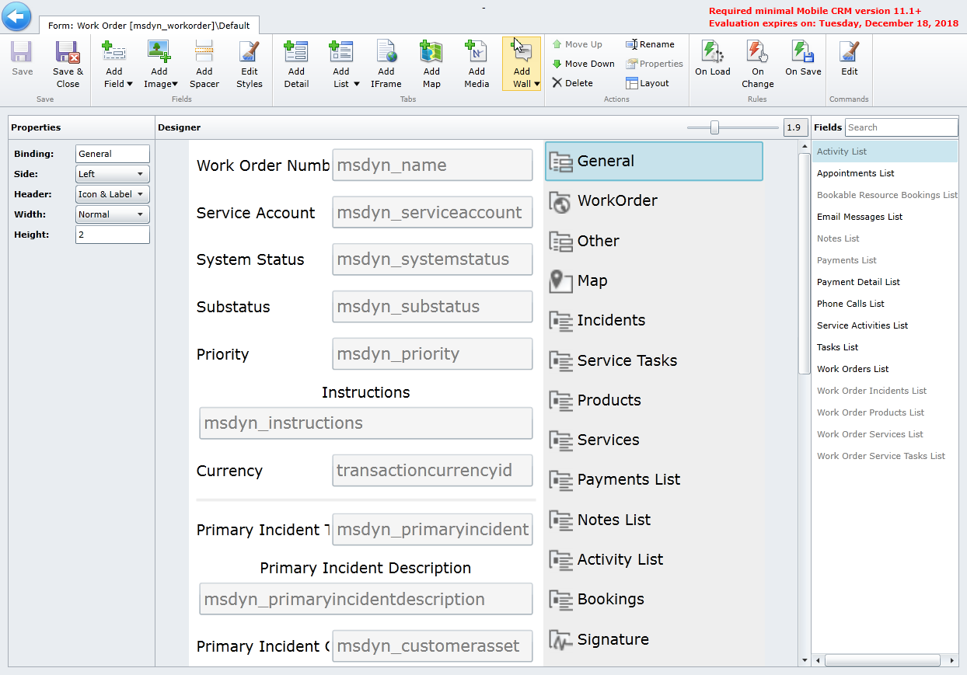
Additional fields can be added to the available list using this button.
Examples of lists that can be added to forms to display related date. Each list has multiple properties that can be defined.
Defines the fields that are displayed on the form
Media control that is configured for signature. Media controls can be used to capture and/or display images, videos and more.

Slide 2
Provides the ability to add commands that can be executed on the form

